Slide 1


Rolf Chung
2025. 06.02

Slide 2

Outline
Executive Summary
Introduction
Methodology
Results
Conclusion
Appendix

Slide 3
Executive Summary - Summary of methodologies
Data Collection:
Used the SpaceX REST API and web scraping techniques to gather historical data on rocket launches.
Processed JSON data into structured formats for analysis, filtering out irrelevant data like Falcon 1 launches.
Data Preprocessing:
Addressed missing values by imputing the mean for numerical fields (e.g., PayloadMass) and applied one-hot encoding for categorical variables.
Created a target variable class
Visualization and Dashboarding:
Leveraged Folium for geospatial analysis and interactive maps to study launch site proximities.
Developed a dashboard using Plotly Dash to provide dynamic insights through interactive charts and controls.
Predictive Modeling:
Built a machine learning pipeline to predict first-stage landing success.
Tested multiple classifiers (Logistic Regression, SVM, Decision Tree, KNN) with hyperparameter tuning via Grid Search.
Performance Evaluation:
Assessed model accuracy, precision, recall, and confusion matrix to identify the most effective predictor.

Slide 4
Executive Summary - Summary of results
Model Performance:
The Decision Tree classifier achieved the best accuracy (83.3%) among all tested models, including KNN, SVM, and Logistic Regression.
It excelled in identifying successful launches (precision: 92.3%, recall: 85.7%), making it highly reliable for predicting successful outcomes.
Predictive Insights:
The model provides valuable predictions to improve operational planning, risk management, and cost estimation for SpaceX launches.
While not revealing direct causes of success, it highlights factors associated with landing outcomes, offering a starting point for further investigation.
Monitoring Tools:
Interactive dashboards and maps developed with Plotly Dash and Folium allow stakeholders to explore launch data dynamically.
These tools facilitate monitoring and operational decision-making by visualizing launch patterns and proximities of landing sites.
Overall, the combination of predictive modeling and interactive analytics tools offers a comprehensive solution for evaluating and optimizing SpaceX operations.

Slide 5
Introduction
The commercial space industry is transforming space travel into a more affordable and accessible venture, with SpaceX leading the charge through innovative cost-saving strategies.
SpaceX's Falcon 9 rocket is a key contributor to its success due to its reusable first stage, significantly reducing launch costs compared to competitors.
A Falcon 9 launch costs approximately $62 million, whereas other providers charge upwards of $165 million.
Reusability of the first stage not only makes launches more economical but also sets SpaceX apart in a competitive market.
The project aims to analyze public data to predict the likelihood of Falcon 9’s first stage successfully landing, which directly impacts launch cost estimation.
Developing maps and dashboards for monitoring the SpaceX operation.
Prediction of Landing Success: Can machine learning models accurately predict whether the Falcon 9 first stage will land successfully?

Slide 6

Section 1

Slide 7
Methodology
Data collection methodology:
The SpaceX launch data was gathered from an API, specifically the SpaceX REST API.
The other source for obtaining Falcon 9 Launch data was web scraping related Wiki pages.
Perform data wrangling
Perform interactive visual analytics using Folium and Plotly Dash
Perform predictive analysis using classification models
How to build, tune, evaluate classification models

Slide 8
Data Collection
The SpaceX launch data was gathered from an API, specifically the SpaceX REST API. The response were a list of JSON objects. These were converted into a data frame using the Python Pandas library.
The other source for obtaining Falcon 9 Launch data was web scraping related Wiki pages. The Python BeautifulSoup package was used to web scrape some HTML tables that contain valuable Falcon 9 launch records.

Slide 9
Data Collection – SpaceX API
Data collection with SpaceX REST API calls:
Identify the API and specific endpoint (e.g., `api.spacexdata.com/v4/launches/past`)
Perform API Request
Use the `requests` library to send a GET request to the API endpoint.
Receive JSON Response in JSON format.
Check Response Status: Verify status code success = 200
If unsuccessful**, log the error and stop. If successful**, proceed.Extract Data**
Call the `.json()`and Normalize JSON method to parse the JSON response into Python objects and a tabular structure.
Convert the normalized JSON into a Pandas DataFrame.
Inspect & Store Data
GitHub repo
https://github.com/RolfChung/Interactive_Vis_SpaceX/blob/main/jupyter-labs-spacex-data-collection-api.ipynbäö##ä
Start
Define data source
Perform API request
Get JSON Response
Check Status
Fail
code: 200
Extract Data
Json to Pandas

Slide 10
Data Collection - Scraping
Setup & Preparation:
Installing and importing Packages: BeautifulSoup , requests
Define Helper Functions
Request and get the HTML data:
Conducting the HTTP Request and set target URL: Wikipedia Falcon 9 launches page
Send GET Request and verify Response: 200 status code
HTML parsing:
Get raw HTML content from response
Extract HTML Text and BeautifulSoup Object
Verify and locate tables Page
Further actions:
Transform the HTML through data wrangling using Python, BeautifulSoup and the helper functions
Start: Setup & Preparation
Request and get the HTML data
HTML parsing
GitHub repo
https://github.com/RolfChung/Interactive_Vis_SpaceX/blob/main/jupyter-labs-webscraping.ipynb

Slide 11
Data Wrangling
Goals
The primary goals for the data wrangling process were:
Perform exploratory data analysis to understand the data. Without this understanding, the next task would not have been possible
Determine the appropriate labels (1 for successful landing, 0 for unsuccessful) for training supervised machine learning models.
Data Wrangling tasks
Data Import from CSV to Pandas DataFrame.
Initial Data Exploration:
missing values, data types
Analyze Launch Sites:
“value_counts()” to count the number of launches from each unique site
Analyze Orbit Occurrences:
“value_counts()” to determine the frequency of each orbit type
Analyze Mission Outcomes:
“value_counts()” to tally the occurrences of different landing outc-omes.
Defining “bad_outcomes” include all outcomes that represent an unsuccessful first stage landing
Create Landing Outcome Label:
A new column ‘class’ is created.
For bad_outcomes `0` is set, `bad_outcomes` Otherwise is set `1`

Slide 12
Data Wrangling – flow chart
Start
Data Import
Initial Data Exploration
This tasks are parallel and not dependent on each other.
Analyze Launch Sites
Analyze Orbit Occurrences
Analyze Mission Outcomes
End
Create Landing Outcome Label
0 or 1

Slide 13
EDA with Data Visualization
What variables are plotted? | Plot type | What is the plot saying?
Relationship of Flight Number and PayloadMass by Class' | sns.catplot as scatterplot | As the flight number increases, the first stage is more likely to land successfully. With more massive payloads, the first stage often returns successfully.
Launch Site of Flight Number and PayloadMass by Class | sns.catplot as scatterplot | As the flight number increases the successful launches are increasing, too. CCFA has the most launches. VAFB has the smallest number of launches. The number of successful launches are similar distributed over the launch sites.
Relationship of launch site and PayloadMass by Class | sns.catplot as scatterplot | Now if you observe Payload Mass Vs. Launch Site scatter point chart you will find for the VAFB-SLC launchsite there are no rockets launched for heavypayload mass(greater than 10000).
Mean success rate by orbit | sns.barplot | The ES-L1, GEO and HEO are the three highest success rates. The ISS and the GTO have low success rates. SO has got a success rate of 0.

Slide 14
EDA with Data Visualization
What variables are plotted? | Plot type | What is the plot saying?
Relationship of FlightNumber and Orbit type by Class | sns.catplot as scatterplot | The LEO orbit, success seems to be related to the number of flights. Conversely, in the GTO orbit, there appears to be no relationship between flight number and success. MEO, VLEO were only used with high FlightNumbers.It seems with increasing FlighNumbers additional orbits were tested. The VLEO orbit has a high success rate an. The SSO has only successes but has not many FlightNumbers. LEO and GTO were used with low FlightNumbers.
Success rate over year | sns.lineplot | From 2010 to 2013 there were none successful launches.The sucess rate since 2013 kept increasing till 2020. In 2018 there was a setback. The peak was 2019 and to 2020 there is small drop.
GitHub URL: https://github.com/RolfChung/Interactive_Vis_SpaceX/blob/main/edadataviz.ipynb
Additionally feature engineering was conducted.

Slide 15
EDA with SQL
Performed SQL queries:
Display the names of the unique launch sites in the space mission: pd.read_sql("SELECT DISTINCT Launch_Site FROM SPACEXTABLE", con)
Display 5 records where launch sites begin with the string 'CCA‘ query_2 = "SELECT Launch_Site FROM SPACEXTABLE WHERE Launch_Site LIKE 'CCA%' LIMIT 5“
Display the total payload mass carried by boosters launched by NASA (CRS) query_3 = "SELECT SUM(PAYLOAD_MASS__KG_) AS TotalPayloadMass_Nasa FROM SPACEXTABLE WHERE Customer LIKE '%NASA (CRS)%' “
Add the GitHub URL of your completed EDA with SQL notebook, as an external reference and peer-review purpose
GitHub URL: https://github.com/RolfChung/Interactive_Vis_SpaceX/blob/main/jupyter-labs-eda-sql-coursera_sqllite.ipynb

Slide 16
EDA with SQL
Display average payload mass carried by booster version F9 v1.1 query_4 = "SELECT AVG(PAYLOAD_MASS__KG_) FROM SPACEXTABLE WHERE Booster_Version LIKE 'F9 v1.1'“
Display average payload mass carried by booster version F9 v1.1 query_4 = "SELECT AVG(PAYLOAD_MASS__KG_) FROM SPACEXTABLE WHERE Booster_Version LIKE 'F9 v1.1'"
List the date when the first succesful landing outcome in ground pad was acheived query_5 = """SELECT MIN(Date) FROM SPACEXTABLE WHERE Landing_Outcome LIKE 'Success (ground pad)'""“
List the names of the boosters which have success in drone ship and have payload mass greater than 4000 but less than 6000 query_6 = """SELECT Booster_Version FROM SPACEXTABLE WHERE Landing_Outcome LIKE 'Success (drone ship)' AND PAYLOAD_MASS__KG_ BETWEEN 4000 AND 6000""“
List the total number of successful and failure mission outcomes query_7a = """SELECT CASE WHEN Mission_Outcome LIKE '%Success%' THEN 'Success' WHEN Mission_Outcome LIKE '%Failure%' THEN 'Failure‘ ELSE 'Error‘ END AS success_or_failure, COUNT(*) AS Total_Count FROM SPACEXTABLE GROUP BY success_or_failure;"""

Slide 17
EDA with SQL
List all the booster_versions that have carried the maximum payload mass. Use a subquery. query_8 = """SELECT Booster_Version FROM SPACEXTABLE WHERE PAYLOAD_MASS__KG_ = (SELECT MAX(PAYLOAD_MASS__KG_ ) FROM SPACEXTABLE);""“
List the records which will display the month names, failure landing_outcomes in drone ship ,booster versions, launch_site for the months in year 2015. query_9 = """SELECT Booster_Version, substr(Date, 6,2) as month, substr(Date, 1, 4) as year, Launch_Site FROM SPACEXTABLE WHERE Landing_Outcome LIKE 'Failure (drone ship)’ AND substr(Date, 1, 4) = '2015';
Rank the count of landing outcomes (such as Failure (drone ship) or Success (ground pad)) between the date 2010-06-04 and 2017-03-20, in descending order. query_9 = """SELECT CASE WHEN Landing_Outcome LIKE "%Success%" THEN "success“ WHEN Landing_Outcome LIKE "%Failure%" THEN "failure“ ELSE "Other“ END AS result, COUNT(Landing_Outcome) Total_Outcome FROM SPACEXTABLE WHERE Date BETWEEN "2010-06-04" AND "2017-03-20“ GROUP BY result ORDER BY Total_Outcome DESC;"""

Slide 18
Build an Interactive Map with Folium
The base site map was build centered around the launch sites
site_map = folium.Map(location=nasa_coordinate, zoom_start=10)
All launch sites were marked on the map
Added a highlighted circle area with a text label on specific launch sites folium.Circle(nasa_coordinate, radius=1000, color='#d35400', fill=True)
Add Folium markers. The markers represent launch sites. marker = folium.map.Marker( nasa_coordinate, icon=DivIcon() ... )
Success/failed launches were marked for each site cluster
Added a marker cluster. Marker clusters are a good way to simplify a map containing many markers having the same coordinate.
For each launch result in spacex_df data frame a folium.Marker was added to marker_cluster. The markers within the cluster makes it easy to distinguish between successful and failed launches easily.
marker_cluster = MarkerCluster()

Slide 19
Build an Interactive Map with Folium
Creating distance markers and line between a launch site and locations in proximity
The locations selected for visualization were a coastline location and the neighboring Florida town of Titusville.
Distances markers were created and placed on the map. distance_marker = folium.Marker( location=coastline_point, icon=DivIcon( ...))
PolyLines between a launch site to the selected locations were drawn. PolyLine( locations=[coastline_coord, launch_site_coord], ... ).add_to(site_map)
Distance markers and PolyLines are valuable for numerous applications like traveling, operations or logistics.
The launch sites are close to coastline. They have access to nearby roads like the Centaur row and railway proximity to the Titan railway. The neighboring town of Titusvile is in some distance. This makes the Florida launch site a good choice for operations and security of SpaceX.
GitHub URL: https://github.com/RolfChung/Interactive_Vis_SpaceX/blob/main/lab_jupyter_launch_site_location.ipynb

Slide 20
Build a Dashboard with Plotly Dash
A SpaceX Launch Records Dashboard od Plotly graphs was created with Dash app.layout and equipped with charts.
Pie chart
A pie chart was added depicting Success vs Failure for every launch site. The specific launch site is selected by a drop-down selection.
The Success vs Failure for every launch site is valuable information. Launch site with a higher success rate could be better launch sites for future launches.
Scatterplot
A 'success-payload-scatter-chart‘ was added depicting the relationship between payload and successes. The specific payload for the launch is selected with a slider graph. The graph is created for a specific launch site selected with the drop-down above. The data points are colored aligned with the booster version.
If given, a correlation between success and payload is valuable information and can guide adjustment to the boosters to increase chances of success.
GitHub URL: https://github.com/RolfChung/Interactive_Vis_SpaceX/blob/main/new_dash_app.py

Slide 21
Predictive Analysis (Classification)
The machine learning pipeline for SpaceX landing prediction involved:
Data Preparation: Separating features and labels, standardizing the feature data, and splitting it into training and test sets.
Model Building & Optimization: Multiple classification models (Logistic Regression, SVM, Decision Tree, KNN) were built. Each model's hyperparameters were tuned using `GridSearchCV` with 10-fold cross-validation on the training data.
Model Evaluation: Performance was rigorously assessed using the test data, calculating accuracy scores, visualizing results with confusion matrices, and providing detailed metrics via classification reports.
Best Model Selection: The final best performing model was identified by comparing the test accuracy scores across all optimized algorithms.
GitHub URL: https://github.com/RolfChung/Interactive_Vis_SpaceX/blob/main/SpaceX_Machine%20Learning%20Prediction_Part_5.ipynb

Slide 22
Predictive Analysis (Classification)
Data import
Model building
Evaluation
Accuracy Score, Confusion Matrix
GridSearch & CrossValidation
Data preprocessing
Create target variable Y
Models
Logistic Regression, Support Vector Machines, Decision Tree, KNN
Model Selection
Standardize training data X
Best performing model: Decision Tree CLF
Train-Test-Split
Summarize how you built, evaluated, improved, and found the best performing classification model
You need present your model development process using key phrases and flowchart
Add the GitHub URL of your completed predictive analysis lab, as an external reference and peer-review purpose

Slide 23
Results - Exploratory data analysis
Higher flight numbers improves success.
Payload mass affects landing success.
Launch sites vary in activity and payload capacity.
Orbit type significantly impacts success rates.
Historical trend shows improving success over time.
Exploratory data analysis results
Interactive analytics demo in screenshots
Predictive analysis results

Slide 24
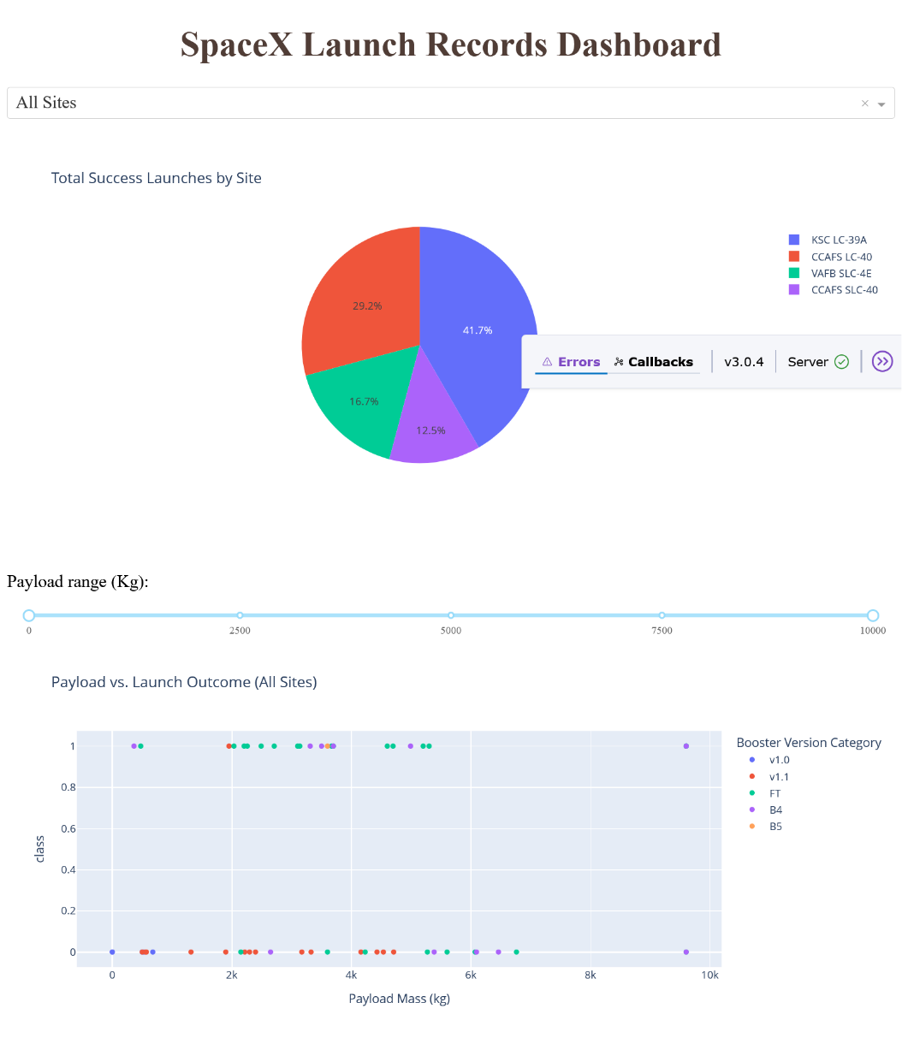
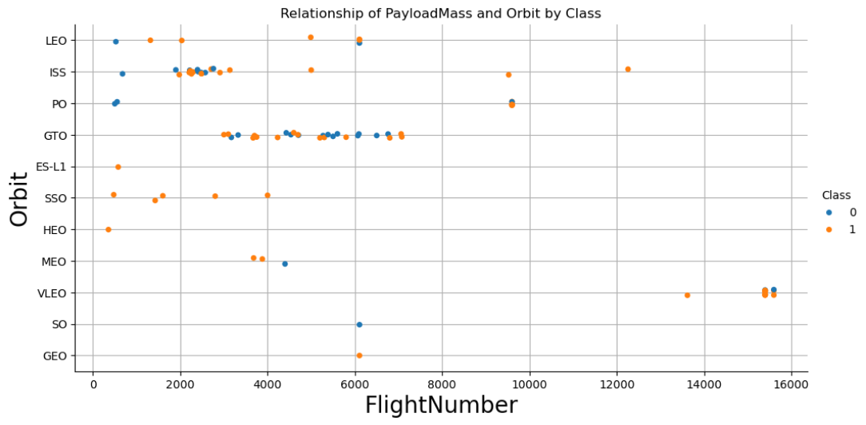
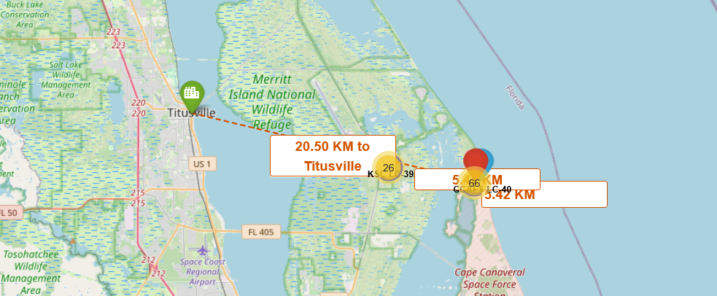
Results - Interactive analytics
Exploratory data analysis results
Interactive analytics demo in screenshots
Predictive analysis results

Slide 25
Results - Predictive analysis
The Decision Tree model outperforms other classifiers such as KNN, SVM, and Logistic Regression on this dataset, achieving the highest accuracy of approximately 83.3%. In general the model adapts well to small datasets.
The classification report reveals that the model performs especially well in identifying successful launches (class 1), with a high precision (92.3%) and recall (85.7%). This means the model is effective at correctly predicting successful launches while minimizing false positives and false negatives.
The result show the decision tree model can be a practical tool for forecasting SpaceX launch outcomes,
Accurate prediction of launch success enables SpaceX and its clients to better manage mission risks, allocate resources efficiently, and reduce costly failures.
The model provides actionable clues that engineers and analysts can explore further to identify and validate the true causes behind successful launches.

Slide 26

Section 2

Slide 27
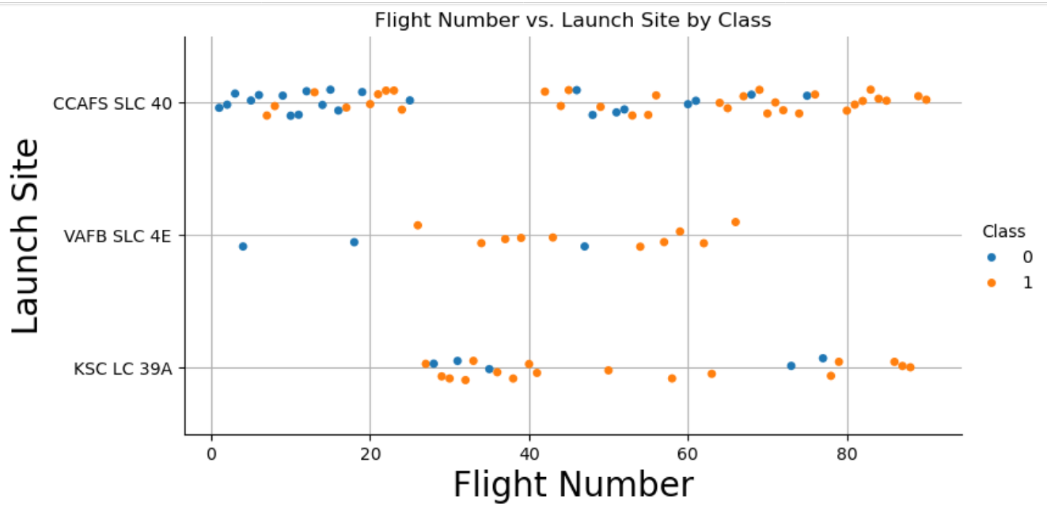
Flight Number vs. Launch Site
As the flight number increases the successful launches are increasing, too.
CCFA has the most launches. VAFB has the smallest number of launches. The number of successful launches are similar distributed over the launch sites. Even VAFB has more successful launches than failures.

Slide 28
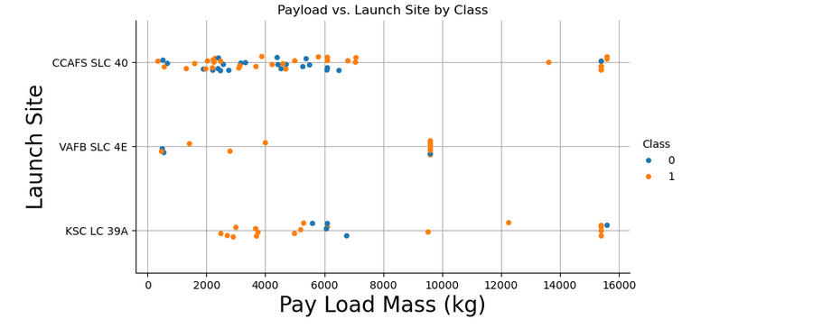
Payload vs. Launch Site
Now if you observe Payload Mass Vs. Launch Site scatter point chart you will find for the VAFB-SLC launchsite there are no rockets launched for heavypayload mass(greater than 10000).
The other launch site have successfully launched payloads of nearly 16000 kg, while have each one failure there.
Most launches are up to 6000 kg.

Slide 29
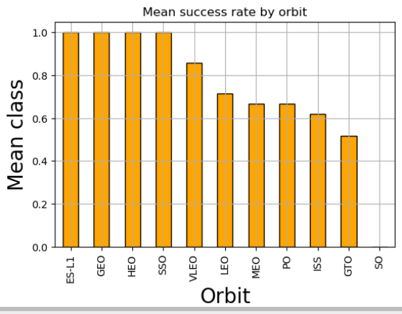
Success Rate vs. Orbit Type
The ES-L1, GEO and HEO are the three highest success rates.
The ISS and the GTO have low success rates.<br>
SO has got a success rate of 0.
Space X should go with the sites having the highest success rates.

Slide 30
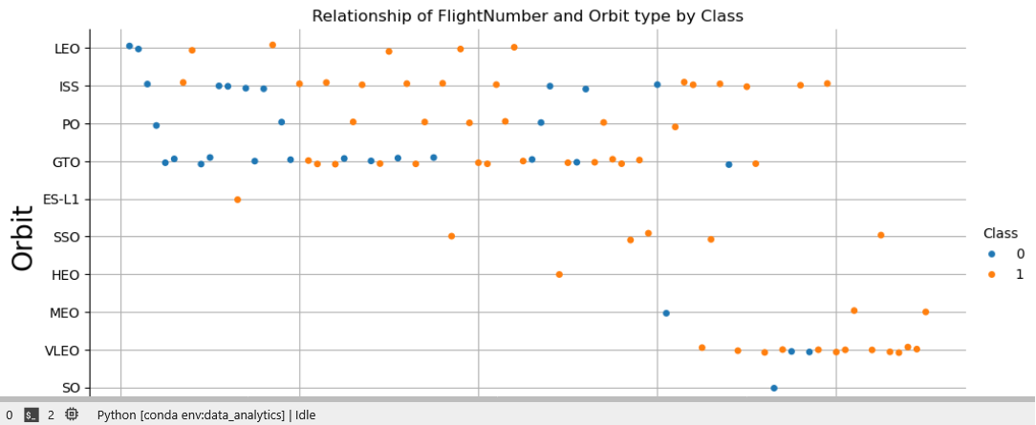
Flight Number vs. Orbit Type
The LEO orbit has a high success rate but a low number of flights. Thesis: Is the number of successes increasing with the number of flights.
Conversely, in the GTO orbit, there appears to be no relationship between flight number and success. MEO, VLEO were only used with high FlightNumbers.
It seems with increasing FlighNumbers additional orbits were tested.
The VLEO orbit has a high success rate an and was used at later flight numbers.
The SSO has only successes but has not many FlightNumbers.
LEO and GTO were used with low FlightNumbers.

Slide 31
Payload vs. Orbit Type
With heavy payloads the successful landing or positive landing rate is higher for Polar,LEO and ISS.
However, for GTO, it's difficult to distinguish between successful and unsuccessful landings as both outcomes are present.
Further analysis is necessary there.
The MEO, VLEO and other orbits are less used at this point.

Slide 32
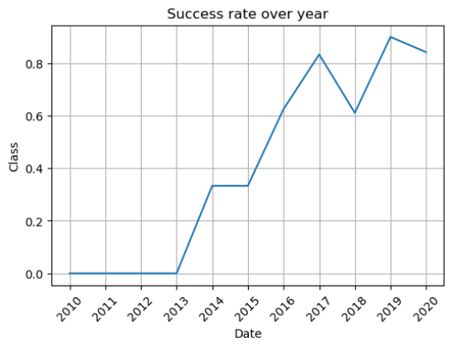
Launch Success Yearly Trend
From 2010 to 2013 there were none successful launches.
The sucess rate since 2013 kept increasing till 2020.
In 2018 there was a setback.
The peak was 2019 and to 2020 there is small drop.

Slide 33
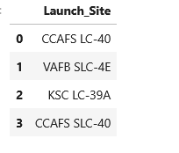
All Launch Site Names
pd.read_sql("SELECT DISTINCT Launch_Site FROM SPACEXTABLE", con)
The unique sites ['CCAFS LC-40', 'VAFB SLC-4E', 'KSC LC-39A', 'CCAFS SLC-40']
Knowing the sites allows to make comparisons with regard to success or failures. Below are the number of launches per site derived.
Launch_Site
CCAFS SLC-40 34
CCAFS LC-40 26
KSC LC-39A 25
VAFB SLC-4E 16

Slide 34
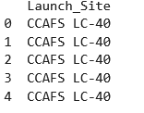
Launch Site Names Begin with 'CCA'
query_2 = \
"SELECT Launch_Site FROM SPACEXTABLE WHERE Launch_Site LIKE 'CCA%' LIMIT 5"
There are two sites: CCAFS LC-40, CCAFS SLC-40
What does the launch sites have in common?

Slide 35
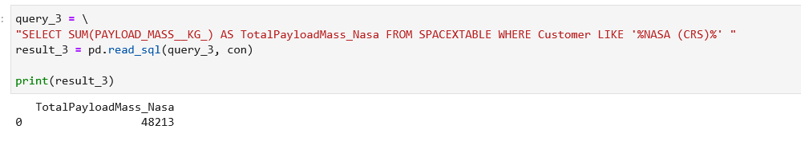
Total Payload Mass
The Total Payload Mass for the customer NASA is 48213 kg.
Several organizations of NASA are customers. It is necessary to summarize all NASA departments to calculate the total payload.

Slide 36
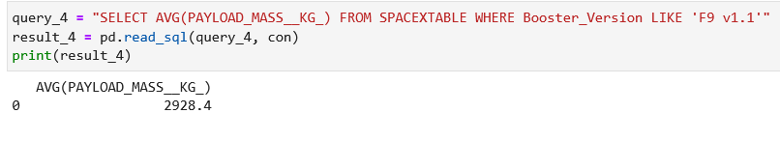
Average Payload Mass by F9 v1.1
Calculate the average payload mass carried by booster version F9 v1.1
The mass is 2928.4 kg.

Slide 37
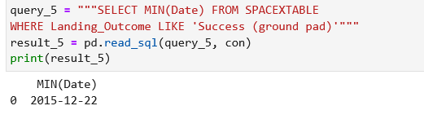
First Successful Ground Landing Date
Find the dates of the first successful landing outcome on ground pad
The the first successful landing outcome on ground pad was: 2015-12-22.
It highlights SpaceX's progress in achieving reusable rocket technology, reducing costs, and advancing space exploration.

Slide 38
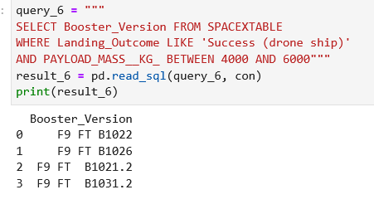
Successful Drone Ship Landing with Payload between 4000 and 6000
It demonstrates SpaceX's success in landing rockets on drone ships under specific payload conditions, which are challenging because of the additional precision required at sea.
This list is a testament to SpaceX's engineering prowess and its achievements in reusability and precision landing technology.

Slide 39
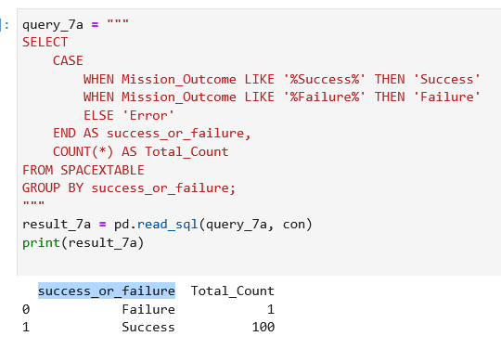
Total Number of Successful and Failure Mission Outcomes
Provides a high-level view of SpaceX's mission success rate, crucial for assessing performance and reliability.
Highlights failure counts, which may point to areas for improvement or investigation.

Slide 40
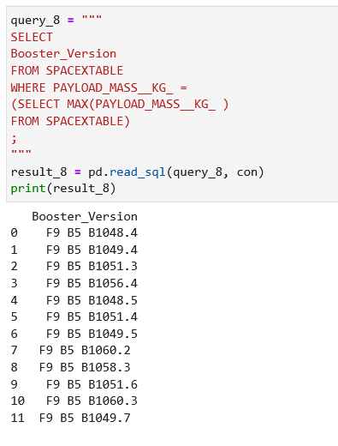
Boosters Carried Maximum Payload
Payload capacity is a key metric for any rocket. This result shows which boosters performed the most challenging missions, carrying the heaviest payloads SpaceX can handle.
The result highlights SpaceX's leading position in payload capacity, cost reduction through reusability, and the operational reliability of Falcon 9 Block 5 boosters. This strengthens their market competitiveness and supports their mission of making space exploration more accessible and affordable.

Slide 41
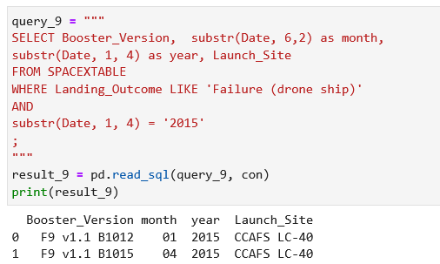
2015 Launch Records
Knowing failures in drone ship landings during a specific year (2015) is crucial for identifying patterns or factors contributing to landing failures.
Early missions in 2015 might have faced technological or operational challenges as SpaceX was perfecting its drone ship landing technology.

Slide 42
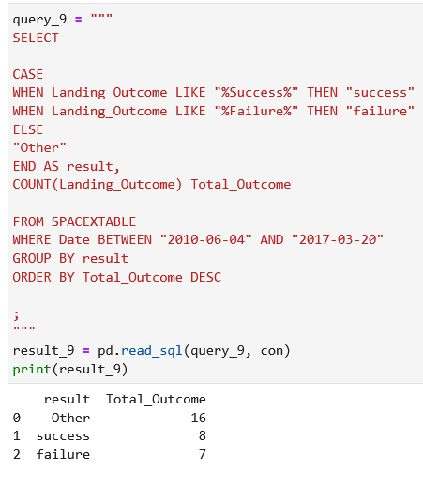
Rank Landing Outcomes Between 2010-06-04 and 2017-03-20
The relatively low success count (8) and failure count (7) reflect that this was the early era of SpaceX’s landing attempts (before 2017).
This data highlights the challenges SpaceX faced and the milestones achieved in refining their technology.

Slide 43

Section 3

Slide 44
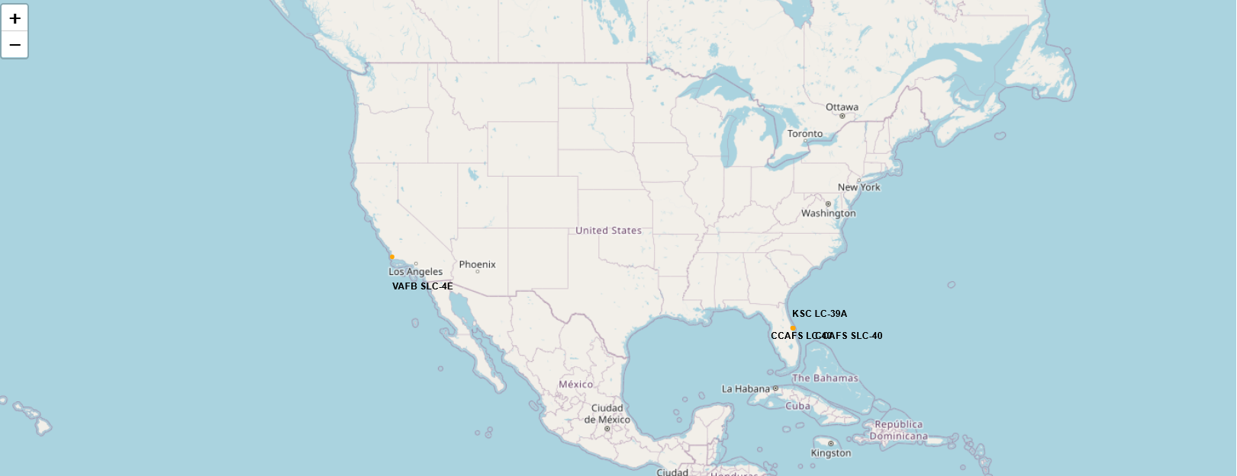
Map include all launch sites location markers on a global map
The map highlights the geographical distribution of SpaceX's launch sites.
Key launch sites visible include CCAFS LC-40, CCAFS SLC-40 (Space Launch Complex 40 at Cape Canaveral), KSC LC-39A (Kennedy Space Center, Launch Complex 39A)
Most launch sites are clustered in Florida, indicating the region's strategic importance for space launches due to its proximity to the equator and large open waters for safety.

Slide 45
Map to show the color-labeled launch outcomes on the map
The marker_color field dynamically assigns colors to markers based on launch outcomes in the SpaceX DataFrame.
Success: green successful launch outcomes. / Failure: red failed launch outcomes.
Clusters of success markers highlight consistently successful launch sites mostly in Florida.
It helps SpaceX pinpoint areas for technical improvements or policy adjustments.
Patterns in failure-prone areas might guide further investigations into environmental, technical, or logistical factors.

Slide 46
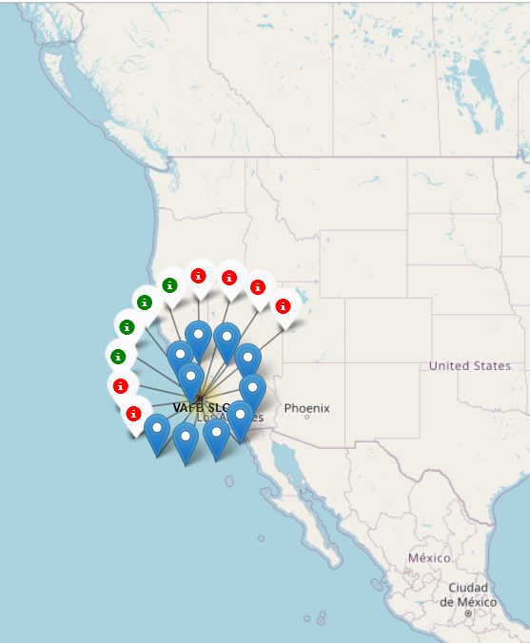
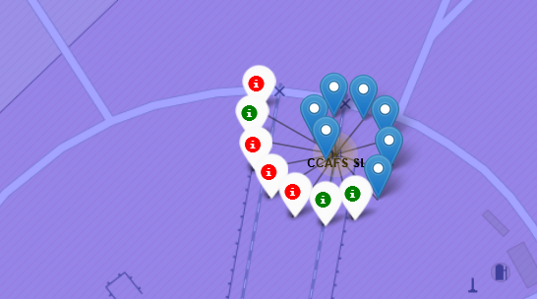
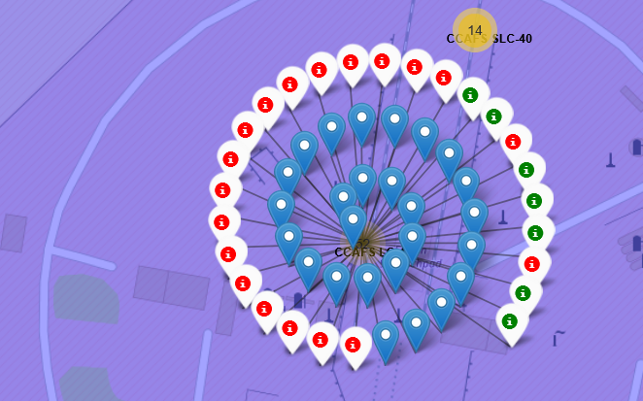
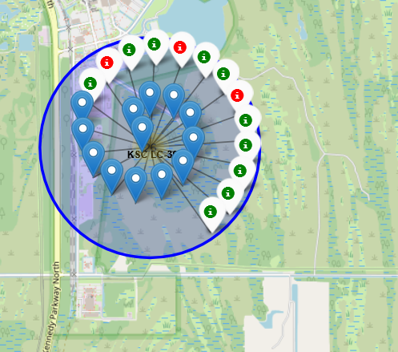
Map include all launch sites location markers on a global map

Slide 47
Map showing proximities such as railway, highway, coastline, with distance calculated and displayed
The interactive map is created using Folium and allows users to explore distances and relationships between SpaceX launch sites and nearby points of interest, in this case Titusville Florida
A dashed Polyline connects Titusville and the SpaceX launch site.
A custom label is placed at the midpoint of the Polyline, showing the calculated distance between Titusville and the launch site (20.5 km in this example).
Titusville Marker: Green marker with a "city" icon, representing Titusville, FL.
Launch Site Marker: Red marker with a "rocket" icon, denoting the SpaceX launch site.
The map emphasizes the close distance between Titusville and the SpaceX launch site (approximately 20.5 km). This proximity underlines the strategic location of Titusville as a support hub for SpaceX operations..

Slide 48
Map showing proximities SpaceX and Titusville

Slide 49

Section 4

Slide 50
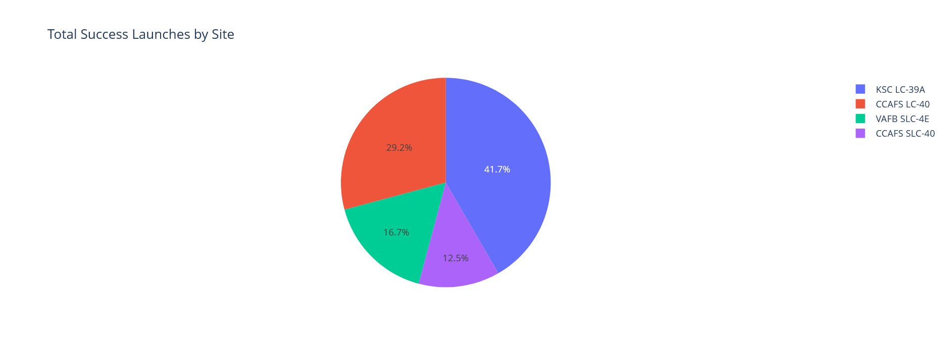
Graph of launch success count for all sites in a piechart
KSC LC-39A's Dominance Handling 41.7% of successful launches signifies its importance as SpaceX’s flagship site, capable of supporting diverse and high-profile missions.
If KSC LC-39A has fewer total launches compared to other sites, the success rate percentage might overstate the importance.
Cape Canaveral Air Force Station's LC-40 (29.2%) is the second-most significant contributor.
Supports a substantial portion of SpaceX's launch operations, potentially focusing on commercial satellite launches or medium-scale payloads.
VAFB share indicates a more limited role, possibly supporting specific mission types or a smaller number of launches.
The success rate of the CCAF sites could be combined. Since both sites are geographically close and managed under the same larger facility, treating them as one entity could better represent the region’s overall contribution to SpaceX operations.

Slide 51
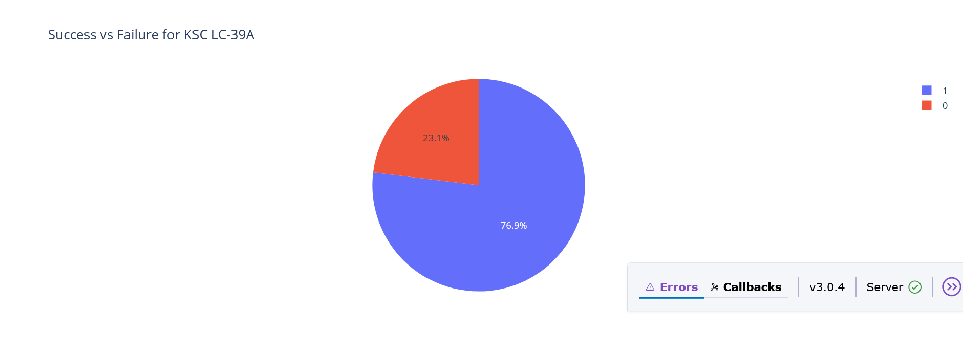
Graph of site with the highest success rate
The graph indicates that "KSC LC-39A" has a success rate of "76.9%". However, the percentage alone doesn't tell the full story. If KSC LC-39A has fewer total launches compared to other sites, the success rate percentage might overstate its operational reliability. Also the CCAF launch sites. This impairs the percentages too.
Given this caveat KSC LC-39A may have optimized infrastructure and processes, allowing it to achieve higher success rates.
This site might have been used for higher-priority or carefully planned missions, which could explain the higher success rate.
A high success rate suggests that KSC LC-39A is a reliable site for SpaceX’s operations, likely benefiting from extensive testing and lessons learned from past launches.

Slide 52
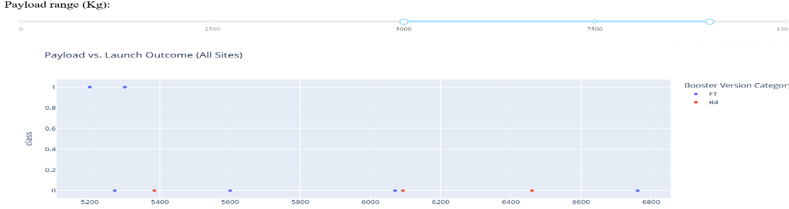
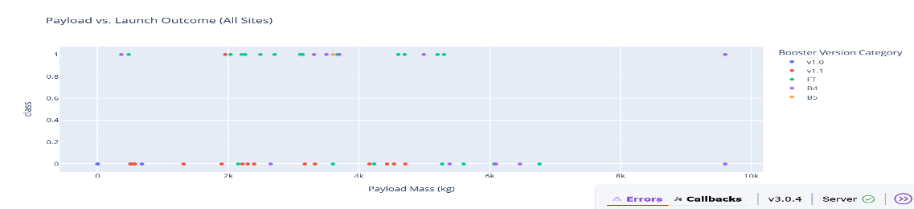
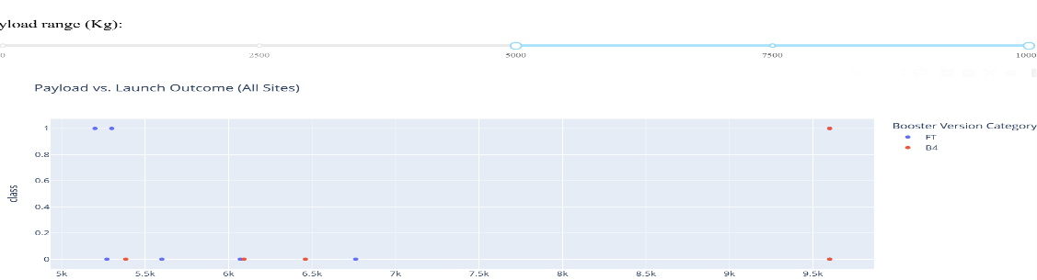
Graph- Payload vs. Launch Outcome scatter plot for all sites, with different payload selected in the range slider
The payload scatter chart is a visualization that explores the relationship between payload mass and launch success outcomes, categorized by booster versions
Lower Payload Mass might show higher success rates as they are less demanding on the rocket's capacity. The challenge for SpaceX is to be successful at higher payloads.
Each booster version might exhibit specific payload mass ranges and associated success rates:
For instance, "F9 v1.1" shows an average payload mass of \~2928 kg, suggesting its design is optimized for medium payloads.
Booster versions like "F9 B5 (various iterations)" are associated with the highest payload masses, showcasing SpaceX's technological progress in launching and reusing rockets with significant capacity.
By filtering payload ranges with the slider users can focus on specific operational windows, such as low-payload missions (<2000 kg) or high-payload launches (>6000 kg), and study trends in success outcomes.
The transition from older booster versions to newer ones (e.g., F9 v1.1 → F9 FT → F9 B5) reflects SpaceX’s increasing ability to handle heavier payloads with higher success rates.

Slide 53

Section 5

Slide 54
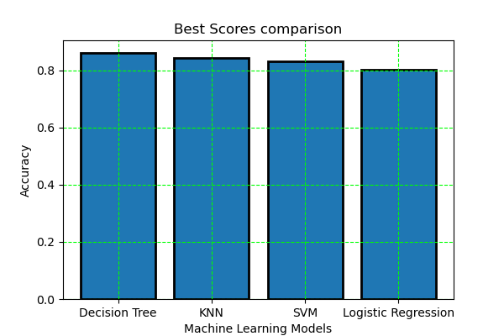
Classification Accuracy
The decision tree model has the best accuracy score.
Given that the dataset is small, the decision tree’s ability to adapt to specific non-linear patterns likely contributes to its high accuracy. Its simplicity ensures that the model doesn’t overfit while still capturing essential relationships in the data.

Slide 55
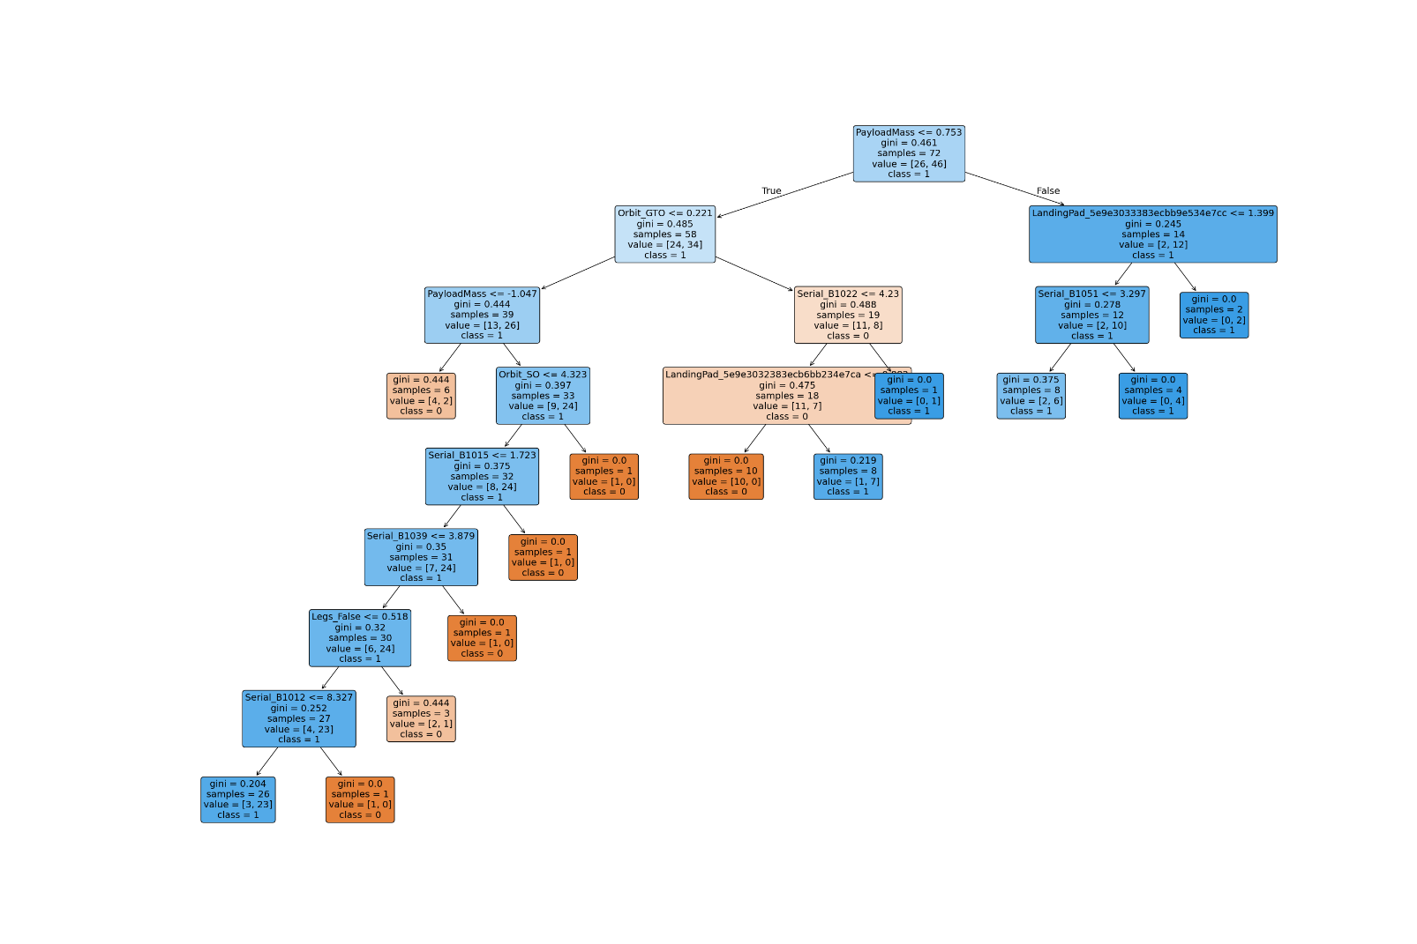
Classification Accuracy
This image shows the plot of the decision tree model.
The root node is PayloadMass.
The first split is between Orbit and LaunchingPad.
The Orbit branch is developed further.

Slide 56
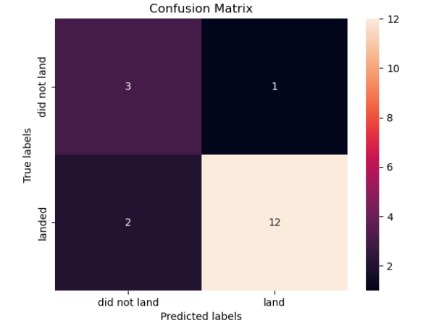
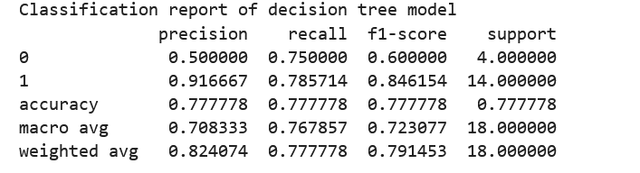
Confusion Matrix
The model does well predicting class 1 (12 correct vs 2 missed).
It performs moderately on class 0 (3 correct vs 1 incorrect).
Overall, it has more correct predictions than mistakes, but some confusion exists especially for class 1 being predicted as 0 (false negatives).

Slide 57
Conclusions
The Decision Tree model outperforms other classifiers such as KNN, SVM, and Logistic Regression on this dataset, achieving the highest accuracy of approximately 83.3%. In general the model adapts well to small datasets.
The classification report reveals that the model performs especially well in identifying successful launches (class 1), with a high precision (92.3%) and recall (85.7%). This means the model is effective at correctly predicting successful launches while minimizing false positives and false negatives.
The result show the decision tree model can be a practical tool for forecasting SpaceX launch outcomes,
Accurate prediction of launch success enables SpaceX and its clients to better manage mission risks, allocate resources efficiently, and reduce costly failures.
The model provides actionable clues that engineers and analysts can explore further to identify and validate the true causes behind successful launches.

Slide 58
Appendix

Slide 59


